Slide 1
CSCI 8360: Data Science Practicum
Lecture 4: “Hidden Technical Debt in Machine Learning Systems” D. Sculley, Gary Holt, Daniel Golovin, Eugene Davydov, Todd Phillips, Dietmar Ebner, Vinay Chaudhary, Michael Young, Jean-Franc ̧ois Crespo, Dan Dennison
Dr. Shannon Quinn
Notes:
All Google employees

Slide 2
What is “technical debt”?
Coined by Ward Cunningham in 1992
Refers to long-term costs incurred by moving quickly in software engineering
Debt metaphor
Not necessarily a bad thing, but always needs to be serviced
Goal: NOT to add new functionality
Enable future improvements, reduce errors, improve maintainability

Slide 3
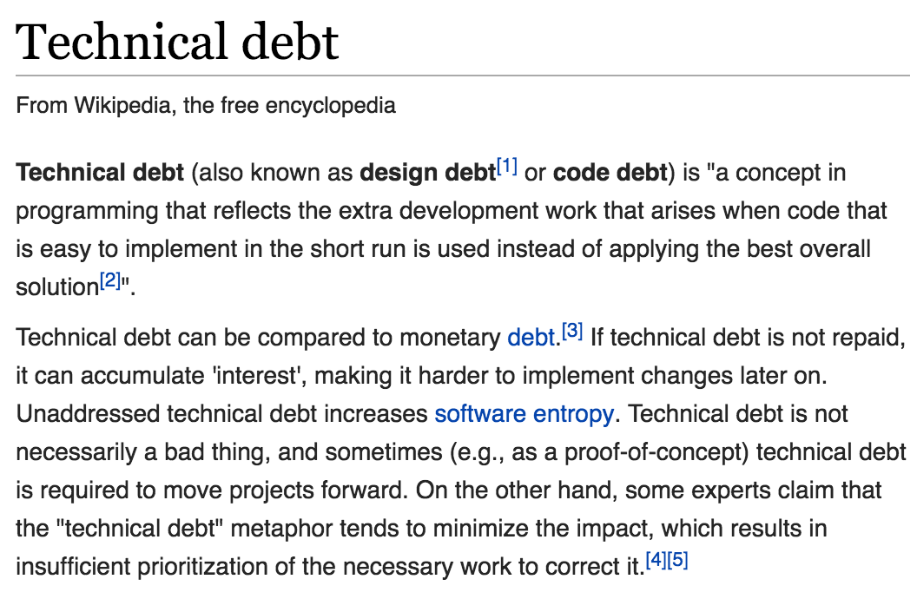
What is “technical debt”?

Slide 4
What is “technical debt”?

Slide 5
What is “technical debt”?

Slide 6
What is “technical debt”?

Slide 7
What is “technical debt”?

Slide 8
Causes of technical debt
Notes:
Business pressures, where the business considers getting something released sooner before all of the necessary changes are complete, builds up technical debt comprising those uncompleted changes.
Lack of process or understanding, where businesses are blind to the concept of technical debt, and make decisions without considering the implications.
Lack of building loosely coupled components, where functions are not modular, the software is not flexible enough to adapt to changes in business needs.
Lack of a test suite, which encourages quick and risky band-aids to fix bugs.
Lack of documentation, where code is created without necessary supporting documentation. That work to create the supporting documentation represents a debt that must be paid.
Lack of collaboration, where knowledge isn't shared around the organization and business efficiency suffers, or junior developers are not properly mentored.
Parallel development at the same time on two or more branches can cause the buildup of technical debt because of the work that will eventually be required to merge the changes into a single source base. The more changes that are done in isolation, the more debt that is piled up.
Delayed refactoring – As the requirements for a project evolve, it may become clear that parts of the code have become unwieldy and must be refactored in order to support future requirements. The longer that refactoring is delayed, and the more code is written to use the current form, the more debt that piles up that must be paid at the time the refactoring is finally done.
Lack of alignment to standards, where industry standard features, frameworks, technologies are ignored. Eventually, integration with standards will come, doing sooner will cost less (similar to 'delayed refactoring').
Lack of knowledge, when the developer simply doesn't know how to write elegant code.
Lack of ownership, when outsourced software efforts result in in-house engineering being required to refactor or rewrite outsourced code.
Poor technological leadership where poorly thought out commands handed down the chain of command increases the technical debt rather than reduce it
Last minute specification changes; these have potential to percolate throughout a project but no time or budget to see them through with documentation and checks
Scope Doping, unmanaged scope reduction or shedding of scope by project managers, or indeed technical staff. Subtly different to Business pressures in that, while business pressures may be a cause, Scope Doping will also cause business pressure due to unmanaged work scope that has been shed.

Slide 9
Technical Debt and Machine Learning
All the maintenance problems of “traditional” code
Plus an additional set of ML-specific concerns
Debt can exist at system level, instead of [strictly] code level
Data influences ML system behavior!
”Traditional” abstractions and boundaries can be corrupted
“Traditional” methods for paying down code-level debt are not sufficient to address ML-specific issues at system level

Slide 10
1: Model Complexity
Traditional software engineering: strong abstraction boundaries, encapsulation, and modular design
Machine learning: desired behavior relies specifically on external data
The real world does not fit into tidy abstraction rules

Slide 11
1: Model Complexity
Entanglement
ML systems mix signals
If we change distribution of one input feature, weights of other d – 1 features may change as well
“Changing Anything Changes Everything”
Correction Cascades
We have model m_{a} for problem A, but need a solution for slightly different A’
Tweak m_{a} to m’_{a}…then need to solve A’’, and so on
Undeclared Consumers
Output of your model m_{a} may be input to some downstream system
Changes in your model m_{a} will drastically affect performance of downstream consumers
Notes:
One possible mitigation strategy is to isolate models and serve ensembles. This approach is useful in situations in which sub-problems decompose naturally such as in disjoint multi-class settings like [14]. However, in many cases ensembles work well because the errors in the component models are uncorrelated. Relying on the combination creates a strong entanglement: improving an individual component model may actually make the system accuracy worse if the remaining errors are more strongly correlated with the other components.
Mitigation strategies are to augment ma to learn the corrections directly within the same model by adding features to distinguish among the cases, or to accept the cost of creating a separate model for A′.
Undeclared consumers may be difficult to detect unless the system is specifically designed to guard against this case, for example with access restrictions or strict service-level agreements (SLAs). In the absence of barriers, engineers will naturally use the most convenient signal at hand, especially when working against deadline pressures.

Slide 12
2: Data Dependencies
Traditional software engineering identifies “dependency debt” as a key contributor to overall technical debt
Data dependencies in ML systems carry similar debt-building capacity, but with the added joy of being more difficult to detect

Slide 13
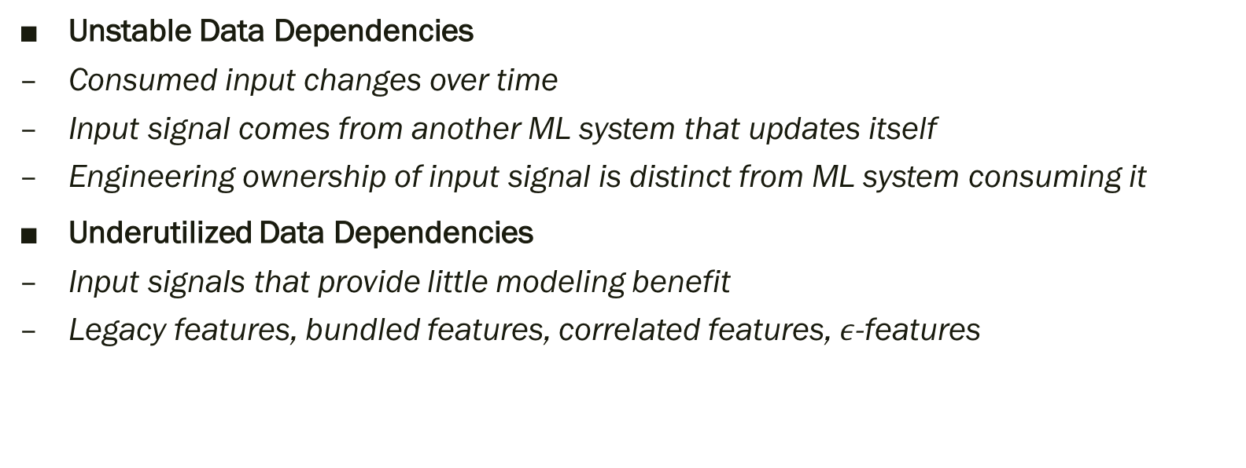
2: Data Dependencies
Unstable Data Dependencies
Consumed input changes over time
Input signal comes from another ML system that updates itself
Engineering ownership of input signal is distinct from ML system consuming it
Underutilized Data Dependencies
Input signals that provide little modeling benefit
Legacy features, bundled features, correlated features, $ε$-features
Notes:
This is dangerous because even “improvements” to input signals may have arbitrary detrimental effects in the consuming system that are costly to diagnose and address. For example, consider the case in which an input signal was previously mis-calibrated. The model consuming it likely fit to these mis-calibrations, and a silent update that corrects the signal will have sudden ramifications for the model.
One common mitigation strategy for unstable data dependencies is to create a versioned copy of a given signal. For example, rather than allowing a semantic mapping of words to topic clusters to change over time, it might be reasonable to create a frozen version of this mapping and use it until such a time as an updated version has been fully vetted. Versioning carries its own costs, however, such as potential staleness and the cost to maintain multiple versions of the same signal over time.
Underutilized dependencies can be detected via exhaustive leave-one-feature-out evaluations. These should be run regularly to identify and remove unnecessary features.

Slide 14
3: Feedback Loops
A key feature of ML systems is influencing its own behavior
Analysis debt
Difficult to predict behavior of a given model before release*
* Tay?

Slide 15
3: Feedback Loops
Direct Feedback Loops
Model directly influences selection of its own future training data
Supervised algorithms
Hidden Feedback Loops
Two systems indirectly influence each other through the world
Related but distinct recommendation systems—improving one leads to changes in the other
Notes:
It is possible to mitigate these effects by using some amount of randomization [3], or by isolating certain parts of data from being influenced by a given model.

Slide 16
4: ML System Anti-patterns
How much code in a machine learning system is, well, machine learning?
The non-ML code is “plumbing”—the majority, but nonetheless typically an afterthought.

Slide 17
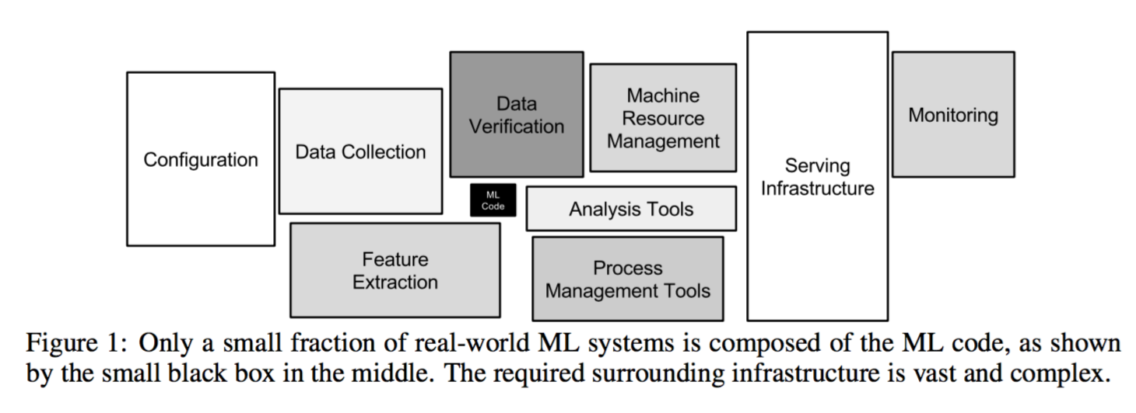
4: ML System Anti-patterns
Notes:
Glue Code. ML researchers tend to develop general purpose solutions as self-contained packages. A wide variety of these are available as open-source packages at places like mloss.org, or from in-house code, proprietary packages, and cloud-based platforms. Using generic packages often results in a glue code system design pattern, in which a massive amount of supporting code is written to get data into and out of general-purpose packages.
Pipeline Jungles. As a special case of glue code, pipeline jungles often appear in data prepara- tion. These can evolve organically, as new signals are identified and new information sources added incrementally. Without care, the resulting system for preparing data in an ML-friendly format may become a jungle of scrapes, joins, and sampling steps, often with intermediate files output.
Dead Experimental Codepaths. A common consequence of glue code or pipeline jungles is that it becomes increasingly attractive in the short term to perform experiments with alternative methods by implementing experimental codepaths as conditional branches within the main production code. For any individual change, the cost of experimenting in this manner is relatively low—none of the surrounding infrastructure needs to be reworked. However, over time, these accumulated codepaths can create a growing debt due to the increasing difficulties of maintaining backward compatibility and an exponential increase in cyclomatic complexity.
Abstraction Debt. The above issues highlight the fact that there is a distinct lack of strong ab- stractions to support ML systems. For distributed learning in particular, there remains a lack of widely accepted abstractions. It could be argued that the widespread use of Map-Reduce in machine learning was driven by the void of strong distributed learning abstractions. Indeed, one of the few areas of broad agreement in recent years appears to be that Map-Reduce is a poor abstraction for iterative ML algorithms. The parameter-server abstraction seems much more robust, but there are multiple competing speci- fications of this basic idea [5, 10]. The lack of standard abstractions makes it all too easy to blur the lines between components.

Slide 18
5: Configuration Debt
Large systems have wide range of configurable options
Features used
Data selection
Algorithm hyperparameters
Verification methods
Pre- and post-processing routines
May reach the point of # of lines of configuration >>> # of lines of code

Slide 19
5: Configuration Debt
It should be easy to specify a configuration as a small change from a previous configuration.
It should be hard to make manual errors, omissions, or oversights.
It should be easy to see, visually, the difference in configuration between two models.
It should be easy to automatically assert and verify basic facts about the configuration: number of features used, transitive closure of data dependencies, etc.
It should be possible to detect unused or redundant settings.
Configurations should undergo a full code review and be checked into a repository.

Slide 20
6: Changes in the External World
Related to #2 ”Data Dependencies” and #3 “Feedback Loops”
Fixed Thresholds in Dynamic Systems
What p(x) will be used to separate “spam” from “not spam”?
Monitoring and Testing
What to monitor?
Prediction Bias (distribution of predicted labels)
Action Limits (automated alerts)
Upstream Producers
Any upstream data producers should also be thoroughly and frequently tested
Notes:
Fixed Thresholds in Dynamic Systems. It is often necessary to pick a decision threshold for a given model to perform some action: to predict true or false, to mark an email as spam or not spam, to show or not show a given ad. One classic approach in machine learning is to choose a threshold from a set of possible thresholds, in order to get good tradeoffs on certain metrics, such as precision and recall. However, such thresholds are often manually set.
Prediction Bias. In a system that is working as intended, it should usually be the case that the distribution of predicted labels is equal to the distribution of observed labels. This is by no means a comprehensive test, as it can be met by a null model that simply predicts average values of label occurrences without regard to the input features.
Action Limits. In systems that are used to take actions in the real world, such as bidding on items or marking messages as spam, it can be useful to set and enforce action limits as a sanity check. These limits should be broad enough not to trigger spuriously. If the system hits a limit for a given action, automated alerts should fire and trigger manual intervention or investigation.
• Up-Stream Producers. Data is often fed through to a learning system from various up- stream producers. These up-stream processes should be thoroughly monitored, tested, and routinely meet a service level objective that takes the downstream ML system needs into account.

Slide 21
7: Other ML-related Debt
Data Testing Debt
If data == code in ML systems, and code should be tested, then some data should be tested as well to monitor for changes in input distributions
Reproducibility Debt (Open Science!)
If frameworks are re-run in identical configurations, should produce identical results
Process Management Debt
Mature systems may have dozens or even hundreds of simultaneous ML models
Cultural Debt
Create a healthy project team culture with a breadth of expertise that rewards good engineering practices
Notes:
Reproducibility Debt. As scientists, it is important that we can re-run experiments and get similar results, but designing real-world systems to allow for strict reproducibility is a task made difficult by randomized algorithms, non-determinism inherent in parallel learning, reliance on initial conditions, and interactions with the external world.
Process Management Debt. This raises a wide range of important problems, including the problem of updating many configurations for many similar models safely and automatically, how to manage and assign resources among models with different business priorities, and how to visualize and detect blockages in the flow of data in a production pipeline.
Cultural Debt. It is important to create team cultures that reward deletion of features, reduction of complexity, improvements in reproducibility, stability, and monitoring to the same degree that improvements in accuracy are valued. In our experience, this is most likely to occur within heterogeneous teams with strengths in both ML research and engineering.

Slide 22
Conclusions
Measuring technical debt
No clear metric
Simply “moving fast” is not evidence of low debt or good practices
Moving quickly often introduces technical debt!
Useful questions for consideration:
How easily can an entirely new algorithmic approach be tested at full scale?
How precisely can the impact of a new change to the system be measured?
Does improving one model or signal degrade others?
How quickly can new members of the team be brought up to speed?
Notes:
Research solutions that provide a tiny accuracy benefit at the cost of massive increases in system complexity are rarely wise practice. Even the addition of one or two seemingly innocuous data dependencies can slow further progress.
Paying down ML-related technical debt requires a specific commitment, which can often only be achieved by a shift in team culture. Recognizing, prioritizing, and rewarding this effort is important for the long term health of successful ML teams.

Slide 23
Questions?

Slide 24
P0 Review
How was it?

Slide 25
P0 Review: Good Version Control Habits
DON’T
DO
Hard-code program arguments (read the instructions)
Include data or program output in version control
Use Jupyter notebooks for program code
Leave commit comments of “p0 update”
Start at the last minute
Use tickets (Issues)
Leave descriptive commit messages (“Fixed bug from ticket #3”)
Create CONTRIBUTORS, LICENSE, and README files
Create a logical directory structure (“src”, “examples”, etc)
Use Jupyter notebooks and toy data sets as examples for new users

Slide 26
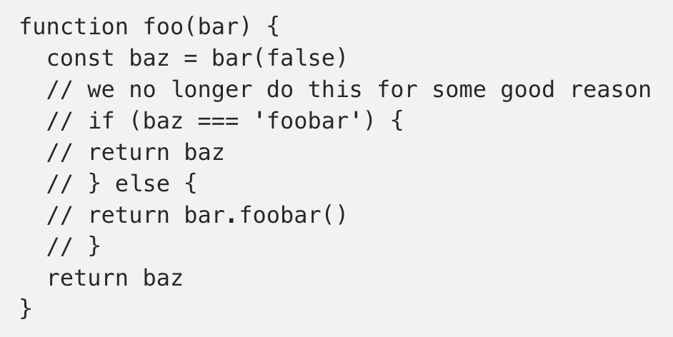
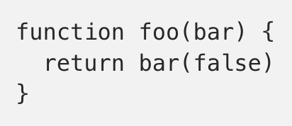

https://blog.kentcdodds.com/please-don-t-commit-commented-out-code-53d0b5b26d5f

Slide 27
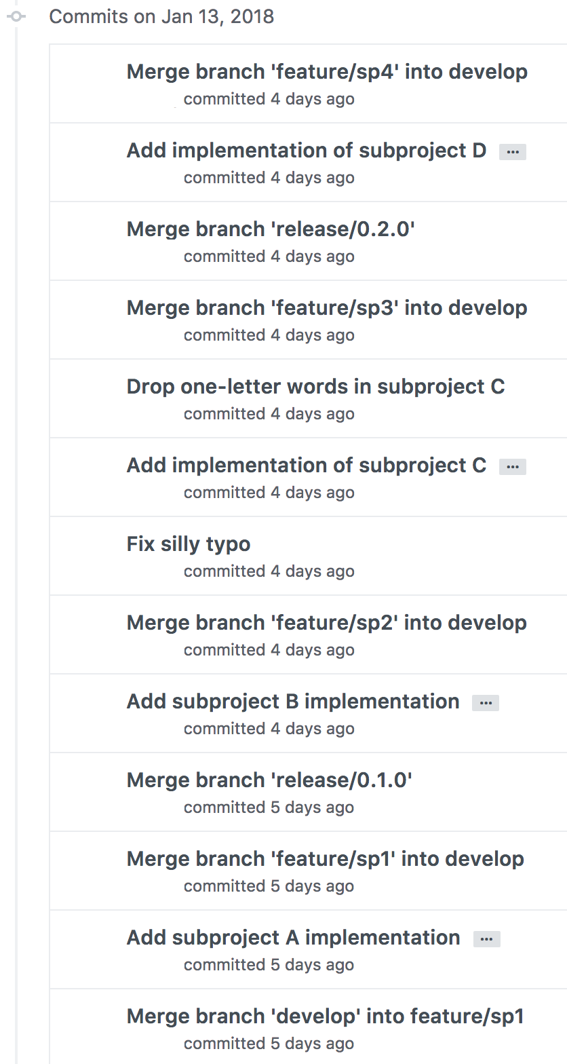
P0 Review: Commit Messages
Actual commit messages from a student
…that’s just 1 day’s worth

Slide 28
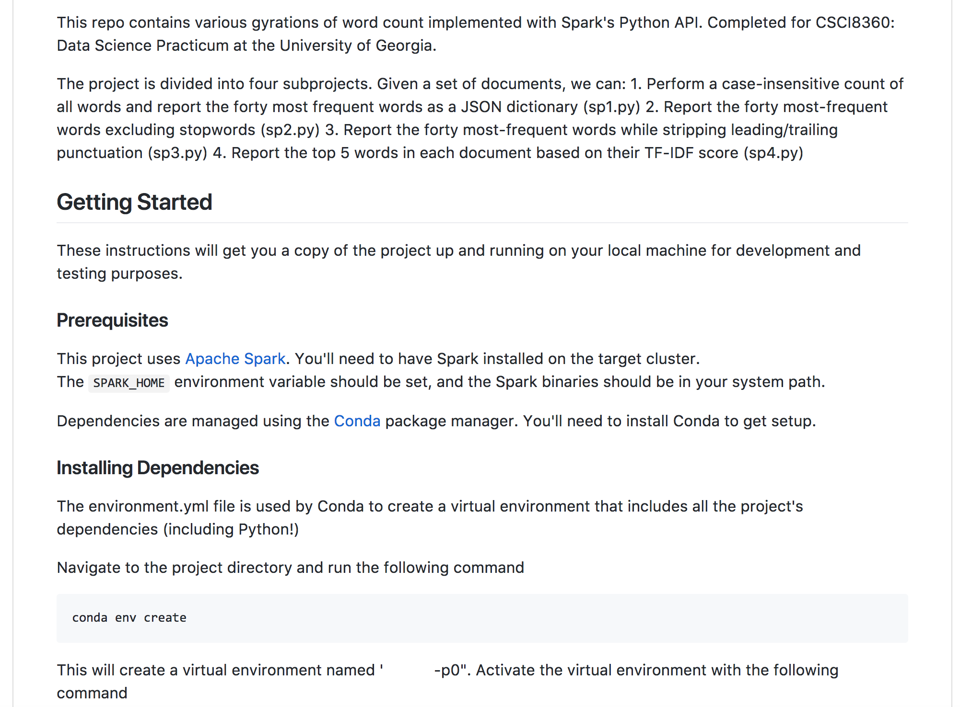
P0 Review: README
Again, an example from a student

Slide 29
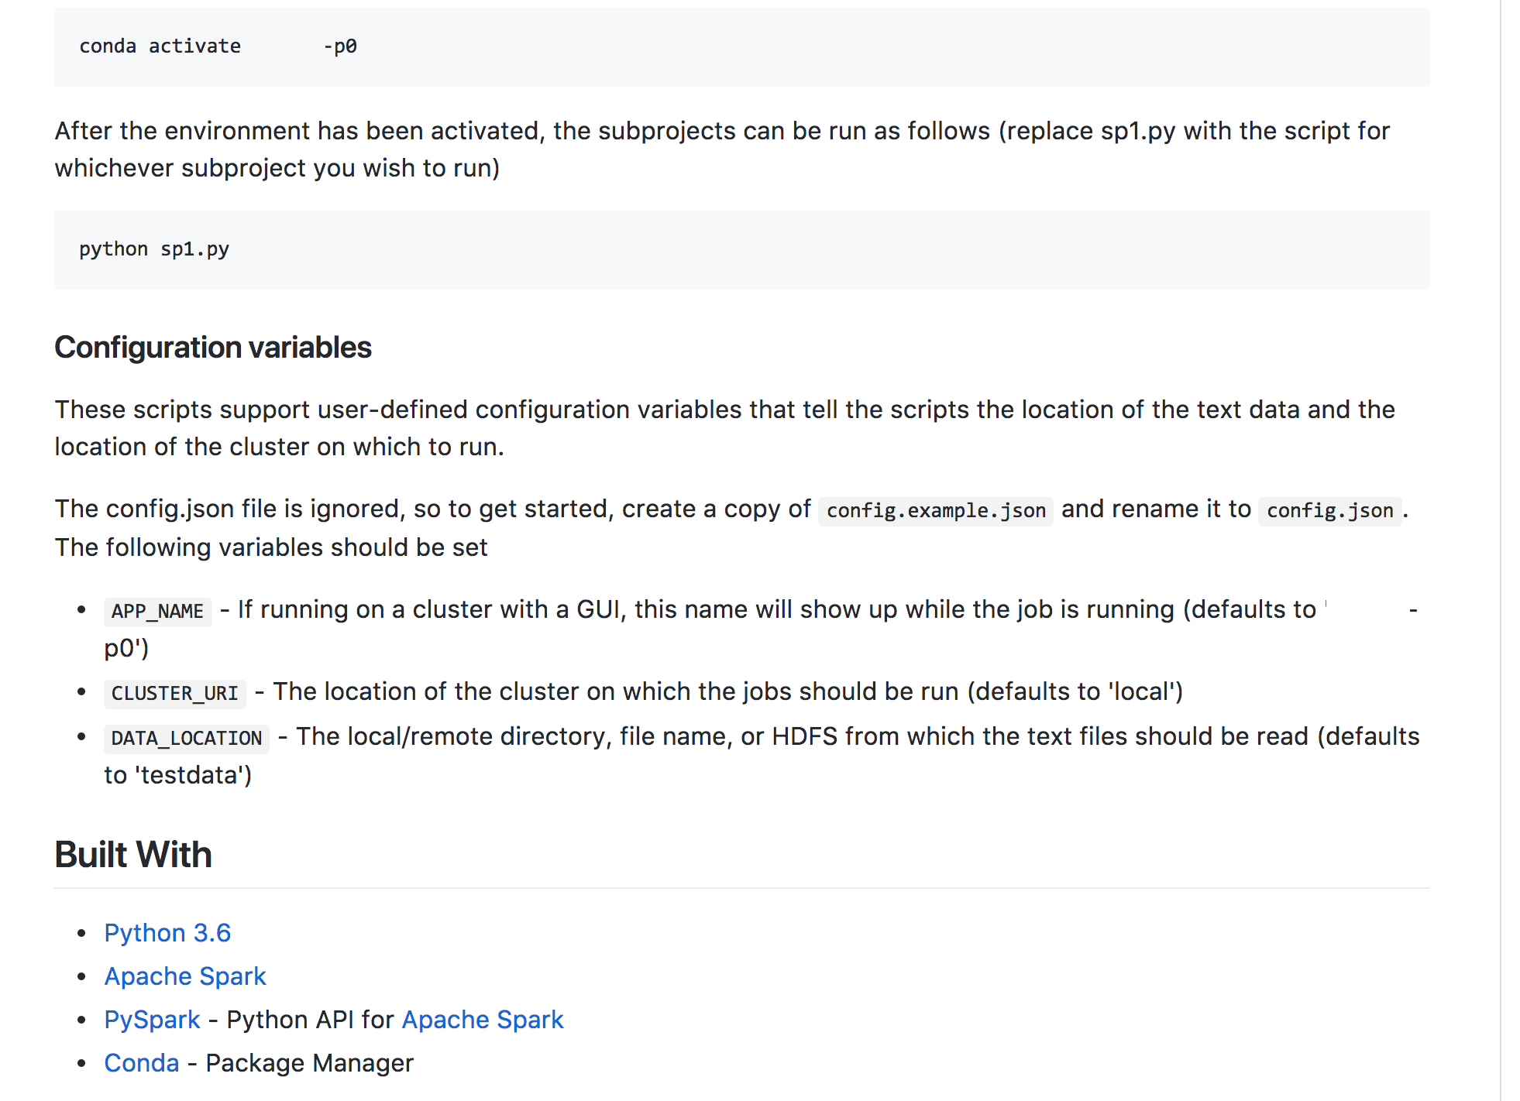

Slide 30
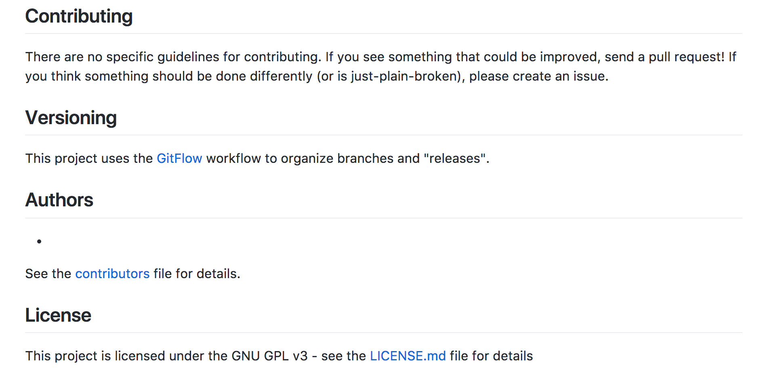

Slide 31
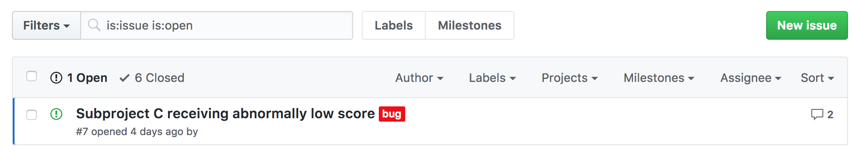
P0 Review: Tickets

Slide 32
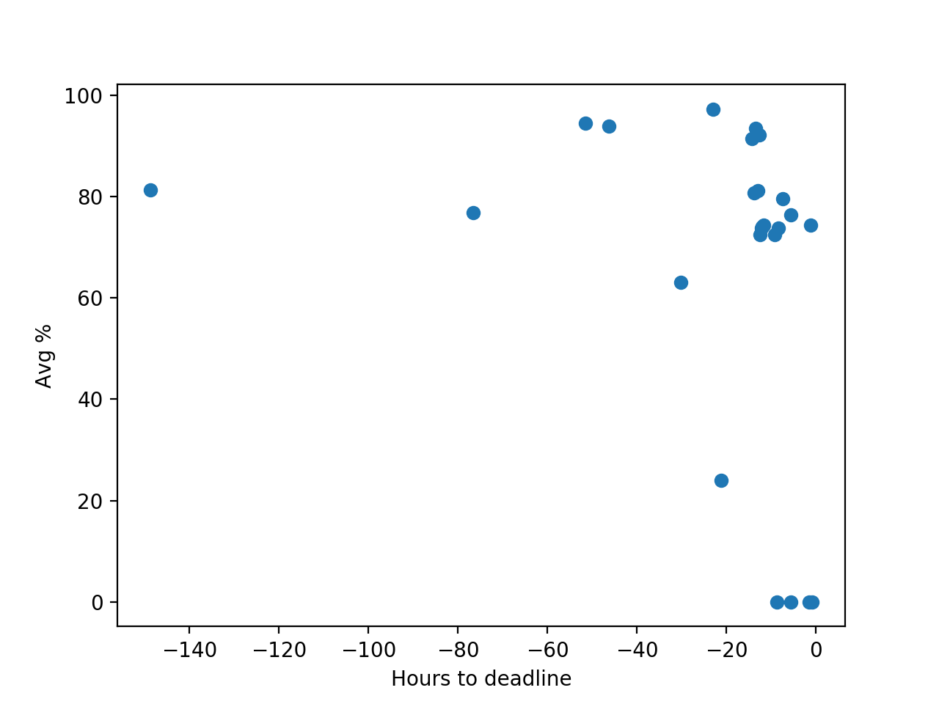
P0 Review
Average score on AutoLab as a function of hours-to-deadline
Yes, R² isn’t great
But seriously: submit early, submit often

